Slide 1
Internal Audit - OpsAudit Customer Surveys

Slide 2
Audit Surveys
The purpose of audit surveys is to reflect on the experience of the project: what was done well and where opportunity exists for improvement on future projects.
These surveys will be sent to key management personnel within the audited business area.
Upon issuance of audit report audit teams will be responsible for sending audit surveys via AuditBoard workstream project.
Survey responses will administered by Luz and she should be assigned as reviewer and project administrator for the survey projects.

Slide 3
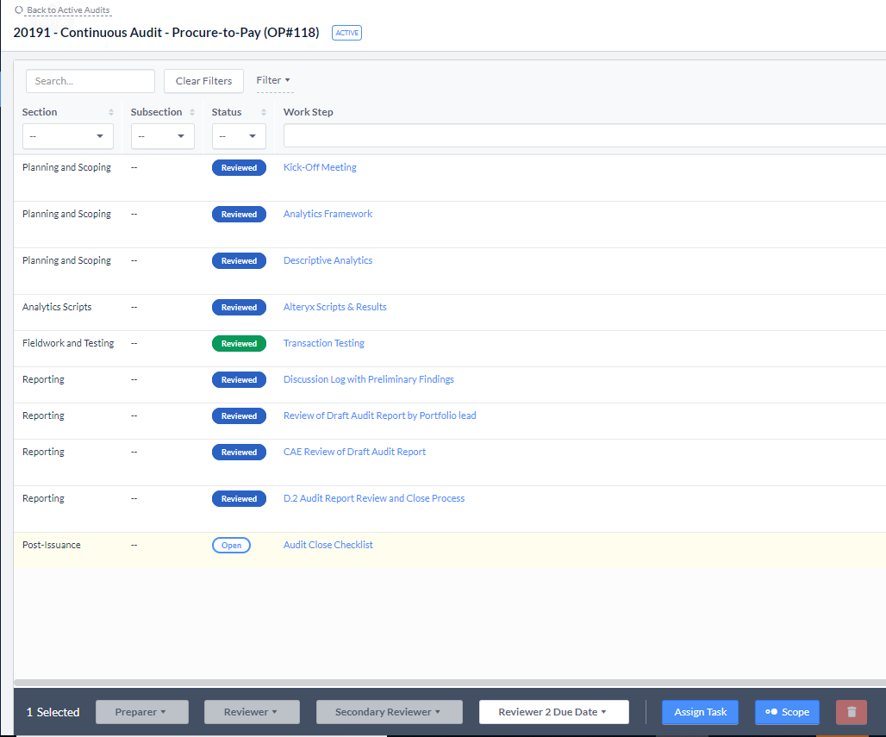
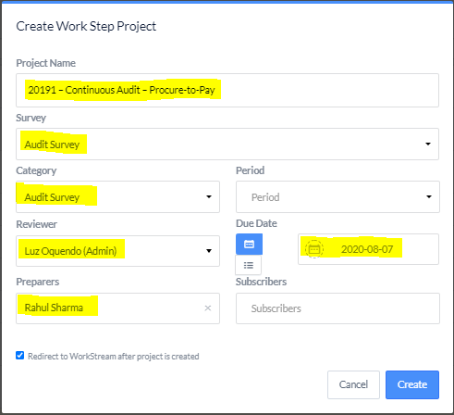
Creating Audit Surveys
To create an audit survey, navigate to the audit list view and highlight on the “Audit Close Checklist” workstep.
Click on the “Assign Task” button located at the bottom of the page and a “Create Work Step Project” box will pop-up.
Within the project populate the following information:
Project Name – (e.g., 20191 – Continuous Audit – Procure-to-Pay)
Survey Type – “Audit Survey”
Reviewer – By default Luz Oquendo will be added as a reviewer.
Preparer – Add customers names
Due Date – Add survey due date
After completing all required fields, click on create button and it will create a workstream project for your Audit Survey.
You will directed to workstream project once the project is created.

Slide 4
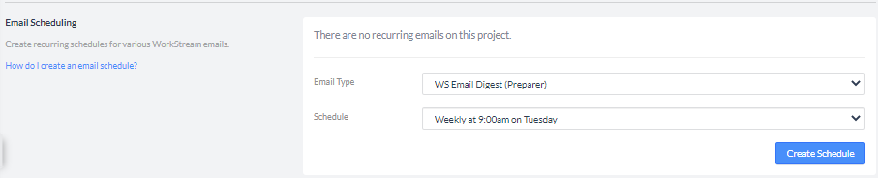
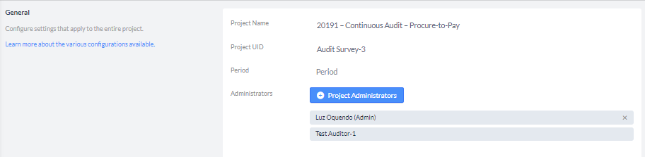
Creating Audit Surveys
Click on the play button on the page to start the project and to send survey email notifications to the customer.
Click on the wrench tool icon to access the project configuration page.
Create a preparer email digest schedule to send periodical reminders to the survey recipient.
Assign Luz Oquendo as project administrator and remove your name as project administrator.
By default the creator of the project will be assigned as the project administrator. Since the survey’s are required to be confidential, send a notification email to Luz and ask her to remove all audit team members from the survey,
Luz will receive email notifications once the surveys are completed and she will share it with the team.

